Slide 1

DriverPass System Analysis
Aaron Doss
Notes:
[No speaker notes required for this slide.]

Slide 2

System Requirements
Nonfunctional requirements
Available through desktop and mobile browsers
Load times should average 1-2 seconds for users
“Forgot password” option to allow users to recover passwords
Functional Requirements
User access to online learning tools
Allow users to select learning packages
Allow users to create accounts
Notes:
The functional requirements depicted in this slide I’ve chosen to show the initial functional requirements that the system would need to meet in order to perform its duty at a baseline level. These functional requirements are: allowing the user to create accounts, allowing the user to select learning packages to purchase, and allowing the user to access the online learning tools included in these packages. All other functional requirements cannot be accessed until the user has engaged with these first three so I decided these to be the most important to list. The non functional requirements I chose involve ensuring a smooth user experience. This includes load times being quick and options to retrieve forgotten passwords for user convenience. This serves DriverPass’s needs through increasing user satisfaction with the system.

Slide 3
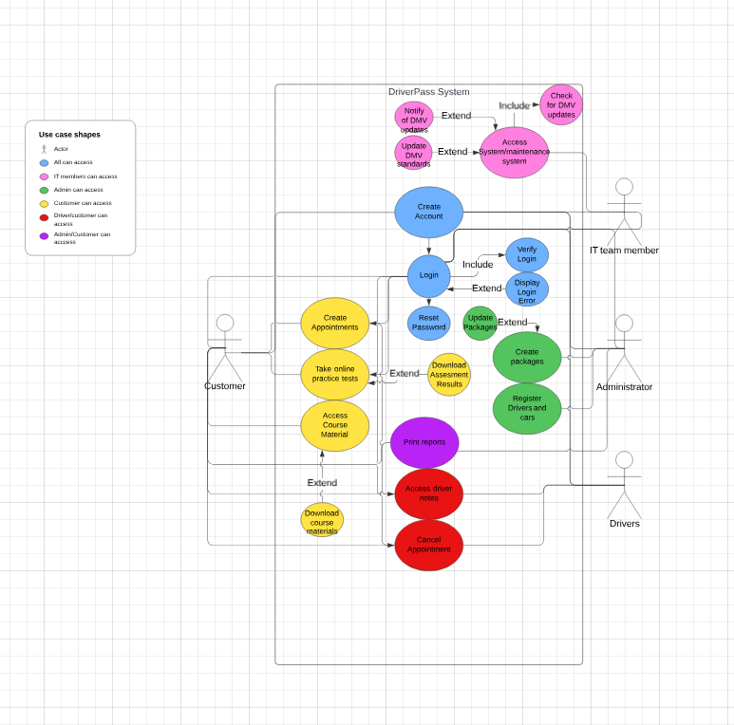
Use Case Diagram
[Insert your use case diagram here.]
Notes:
The system depicted in the provided diagram shows the system DriverPass will be using and the different features that will be accessible by those who use the system. All users will be able to create accounts and login. Customers, after logging in, will be able to purchase lesson packages, create appointments, cancel appointments, take online exams, and access driver notes. Drivers will be able to: cancel appointments and access drivers notes. IT team members will be able to access the system for maintenance and system updates. IT team members will also be in charge of ensuring that DMV standards are up to date on the DriverPass website in accordance with what is available on the DMV website. The administrator will have access to adding/removing packages and editing existing packages. The administrator will also be able to register new drivers and cars as they are acquired by DriverPass.

Slide 4
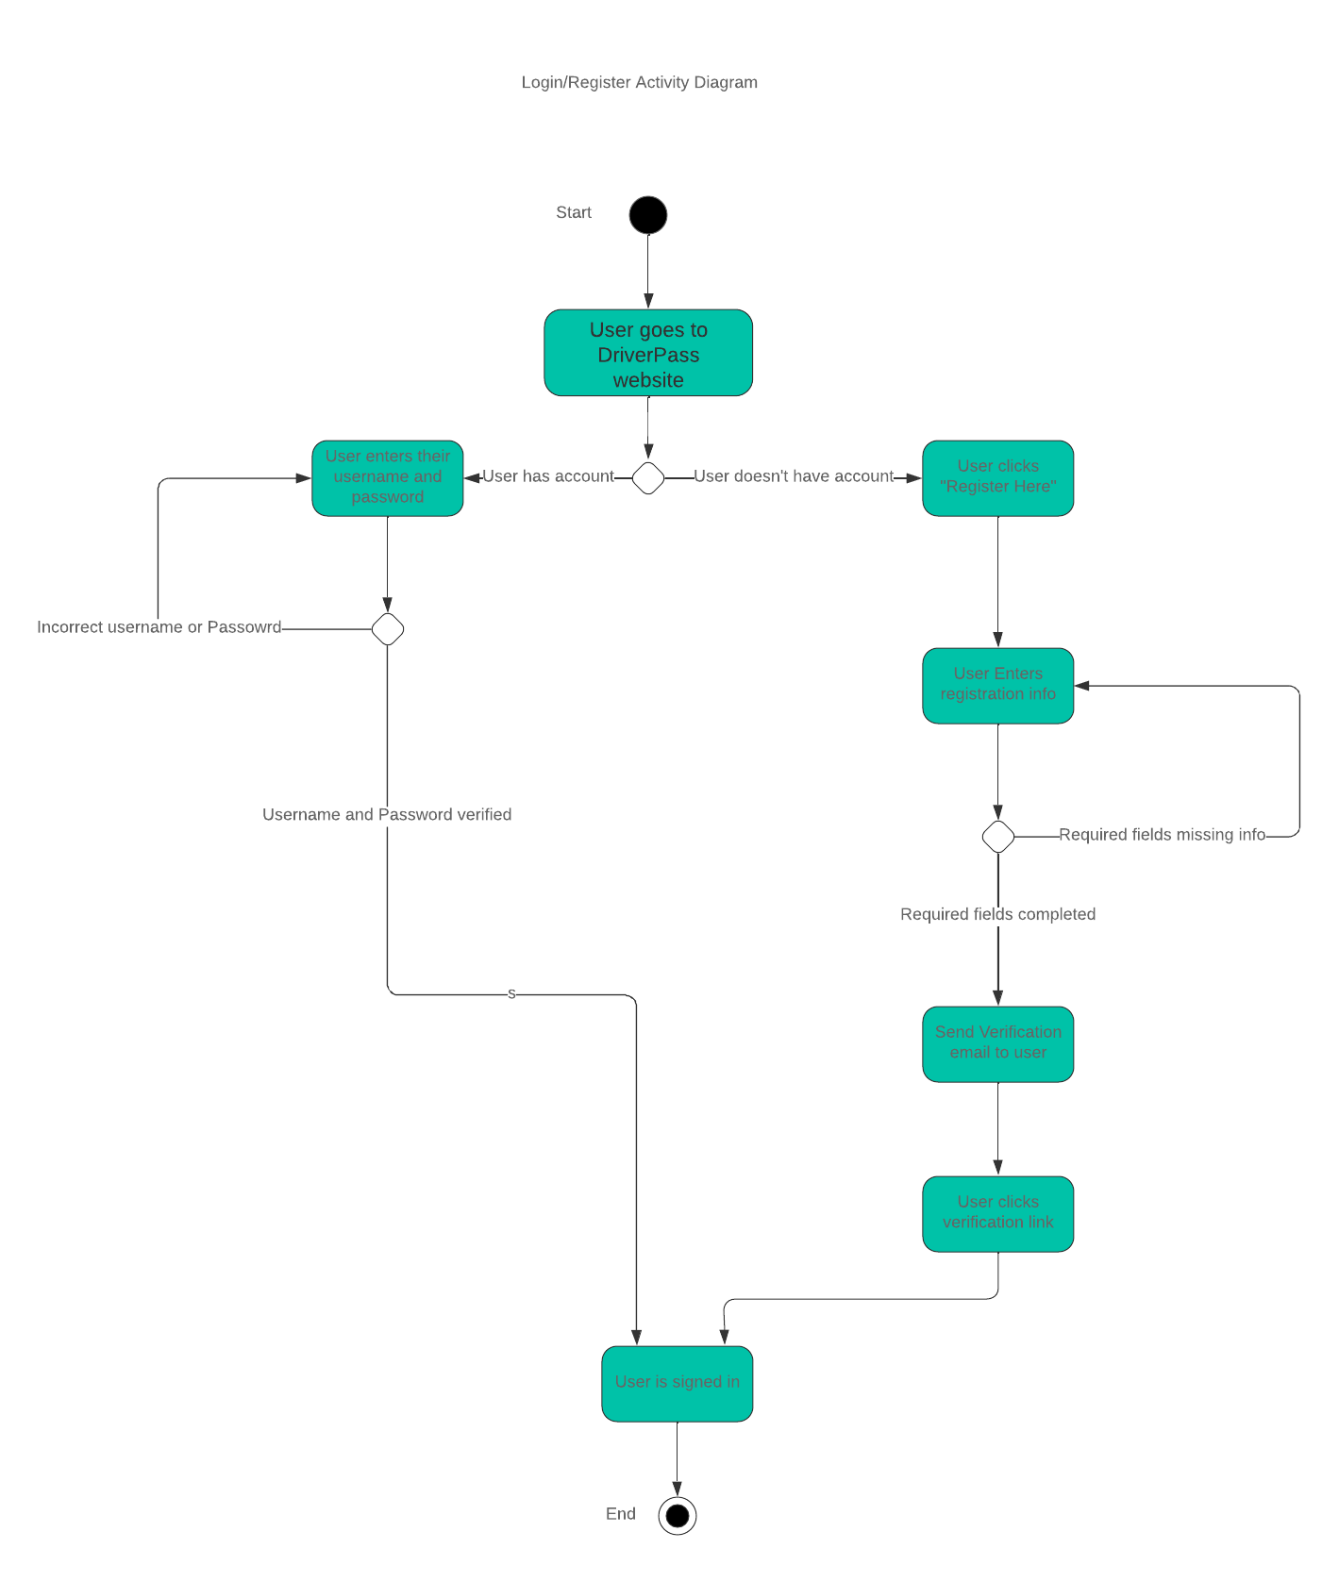
Activity Diagram
[Insert one of your activity diagrams here.]
Notes:
Depicted in this diagram is the process a user will go through to register or login to an account with DriverPass. Initially the user must go to the DriverPass website where they will either be able to log directly into their account or register a new account with DriverPass. Assuming the user has an account they will be prompted to put in their username and password. This username and password is then verified in the system. Assuming it is incorrect, the system will prompt the user again for a username and password. If the verification process is successful the user will be signed in. If the user does not have an account they can click the “Register Here” button which will redirect the user to a registration page where they can put in all required information to create an account. If a field is missing information the user will be prompted to fill in the missing field until all are filled. Once all required fields are filled the user will be sent a verification email to verify their email. Once the user has verified their email they will be logged into the website with their newly created DriverPass account. This will enable new and existing users to interact with DriverPass’s system.

Slide 5
Security
Usernames and passwords required to login
Utilization of HTTPS(Hypertext Transfer Protocol Secure) protocol to encrypt data sent between the client and server
Two-factor authentication will be optional
“Forgot Password” option available to allow users to reset passwords with other identifying information
Notes:
[How did you consider security in your design? In your explanation, keep your audience in mind by avoiding the use of technical terms.]
Security is a very important aspect of website design due to the sensitive information users will be saving on the website. In order to ensure user information remains secure, usernames and passwords will be required for every login attempt. Users will be able to select remember username, however, passwords will be required for every login. The DriverPass website will utilize a method of transferring data from DriverPass to the user in a secure way by encrypting data during the transfer process. Two-factor authentication will be available allowing users to require an additional alternative form of verification through texting the users phone a code when logging in. This will ensure that even if a password and username are compromise the assailant will still need the users phone number to access their account. Users will also have the option to reset their passwords for their own convenience if they forget, or if they believe their account has been compromised. This reset will use other identifying information such as the users email or phone number to send a reset password link to. These security measures will help ensure user data remains secure in the DriverPass system.

Slide 6
System Limitations
DriverPass will initially only have access to 10 cars which will limit the total possible appointments to be available at a given time
Maintenance will be required on the 10 cars further limiting their potential availability
Internet connection issues may result in delay of information transfer from DriverPass to customers or vice-versa
The system must meet DriverPass’s budget
Notes:
There are a few limitations that must be addressed in order to have the system working at its peak efficiency. DriverPass will initially only have access to 10 cars. This will limit the total possible appointments available. Furthermore, maintenance may result in a further limitation of those cars availability. Internet connection issues experienced by the user or DriverPass may result in a delay of information being transferred from the customer to DriverPass or vice-versa. This can be mitigated on the DriverPass side, however, it will be difficult to limit the effects of internet connection issues on the customer side. On top of this, the system will also have to meet DriverPass’s budget, futher limiting the system to a certain extent.

